Slide 1


Slide 2
No, I’m not telling you to go outside!
Far from me!

Slide 3
What is a service worker ?

Slide 4
A service worker is a script that your browser runs in the background, separate from a web page, opening the door to features that don't need a web page or user interaction.

Slide 5


Slide 6
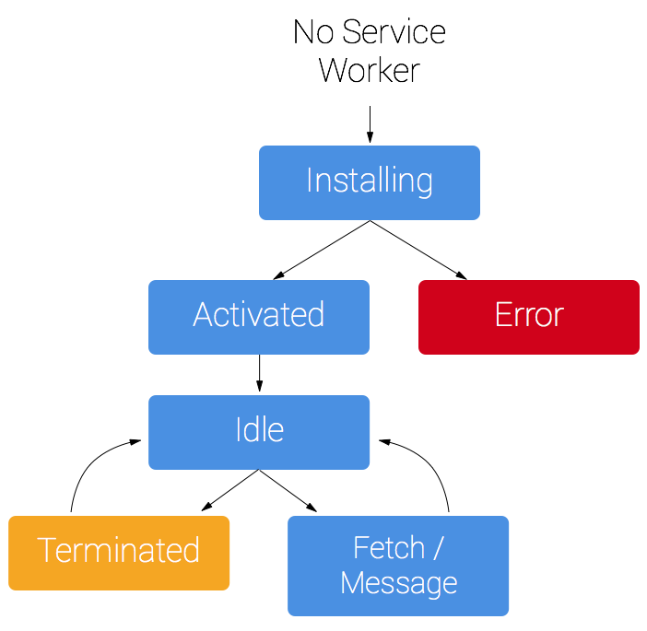

Slide 7
The website stack

Slide 8
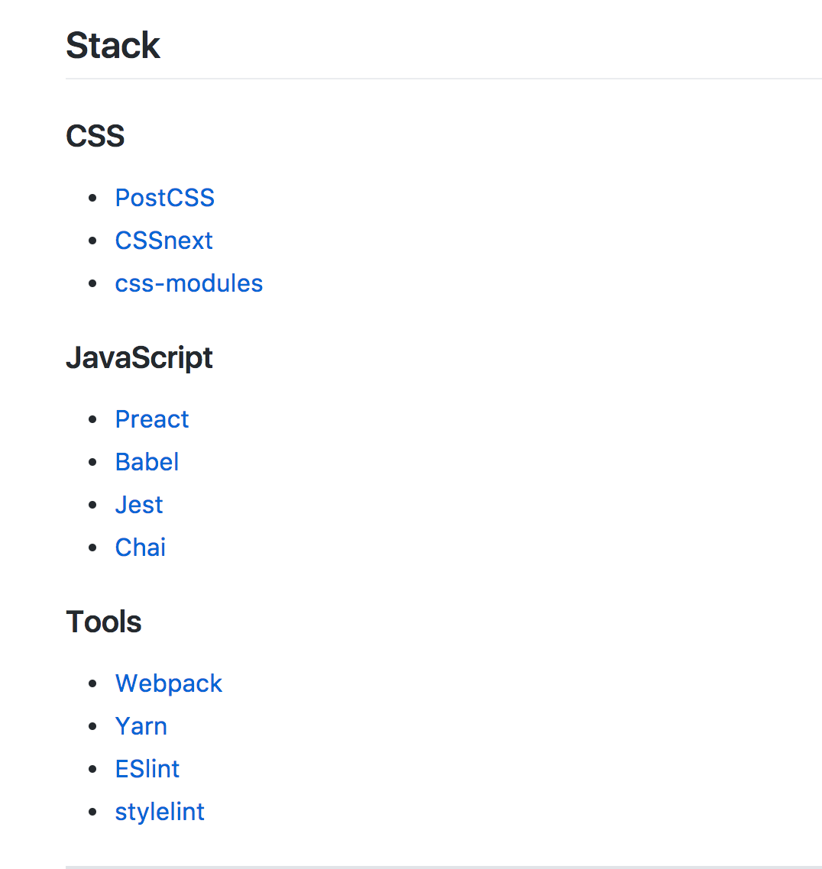

Slide 9
Installing a service worker

Slide 10
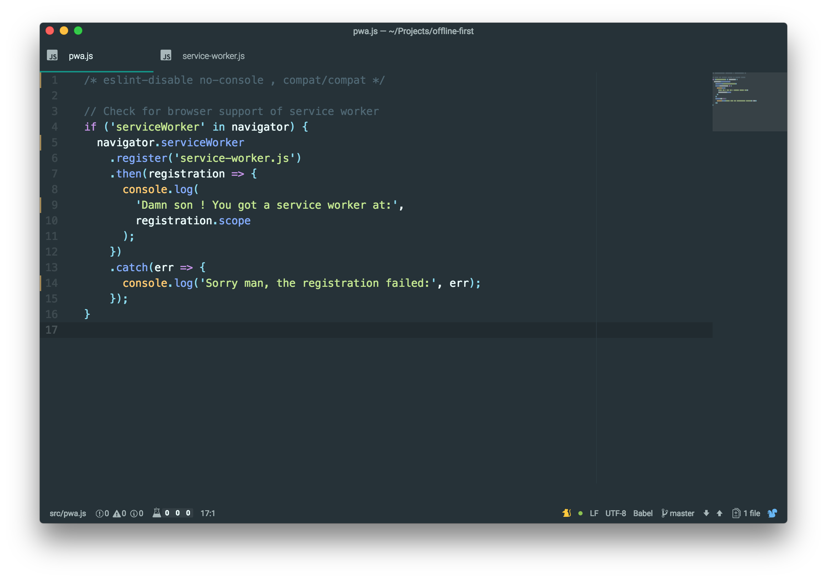

Slide 11
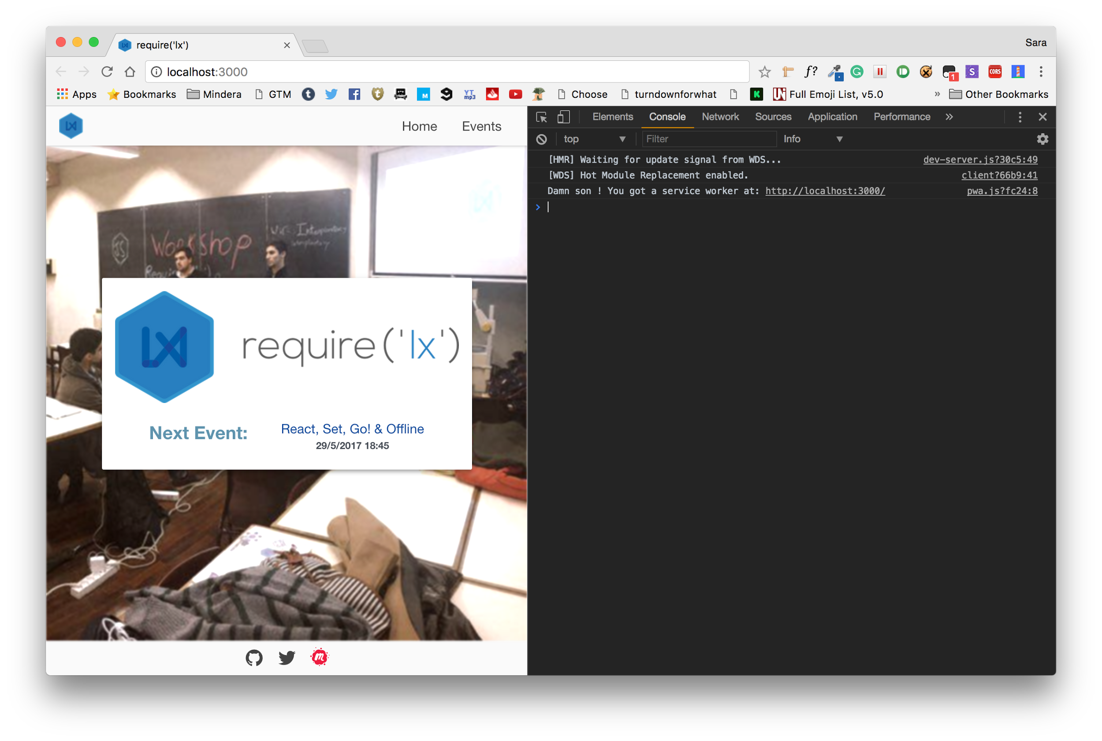

Slide 12
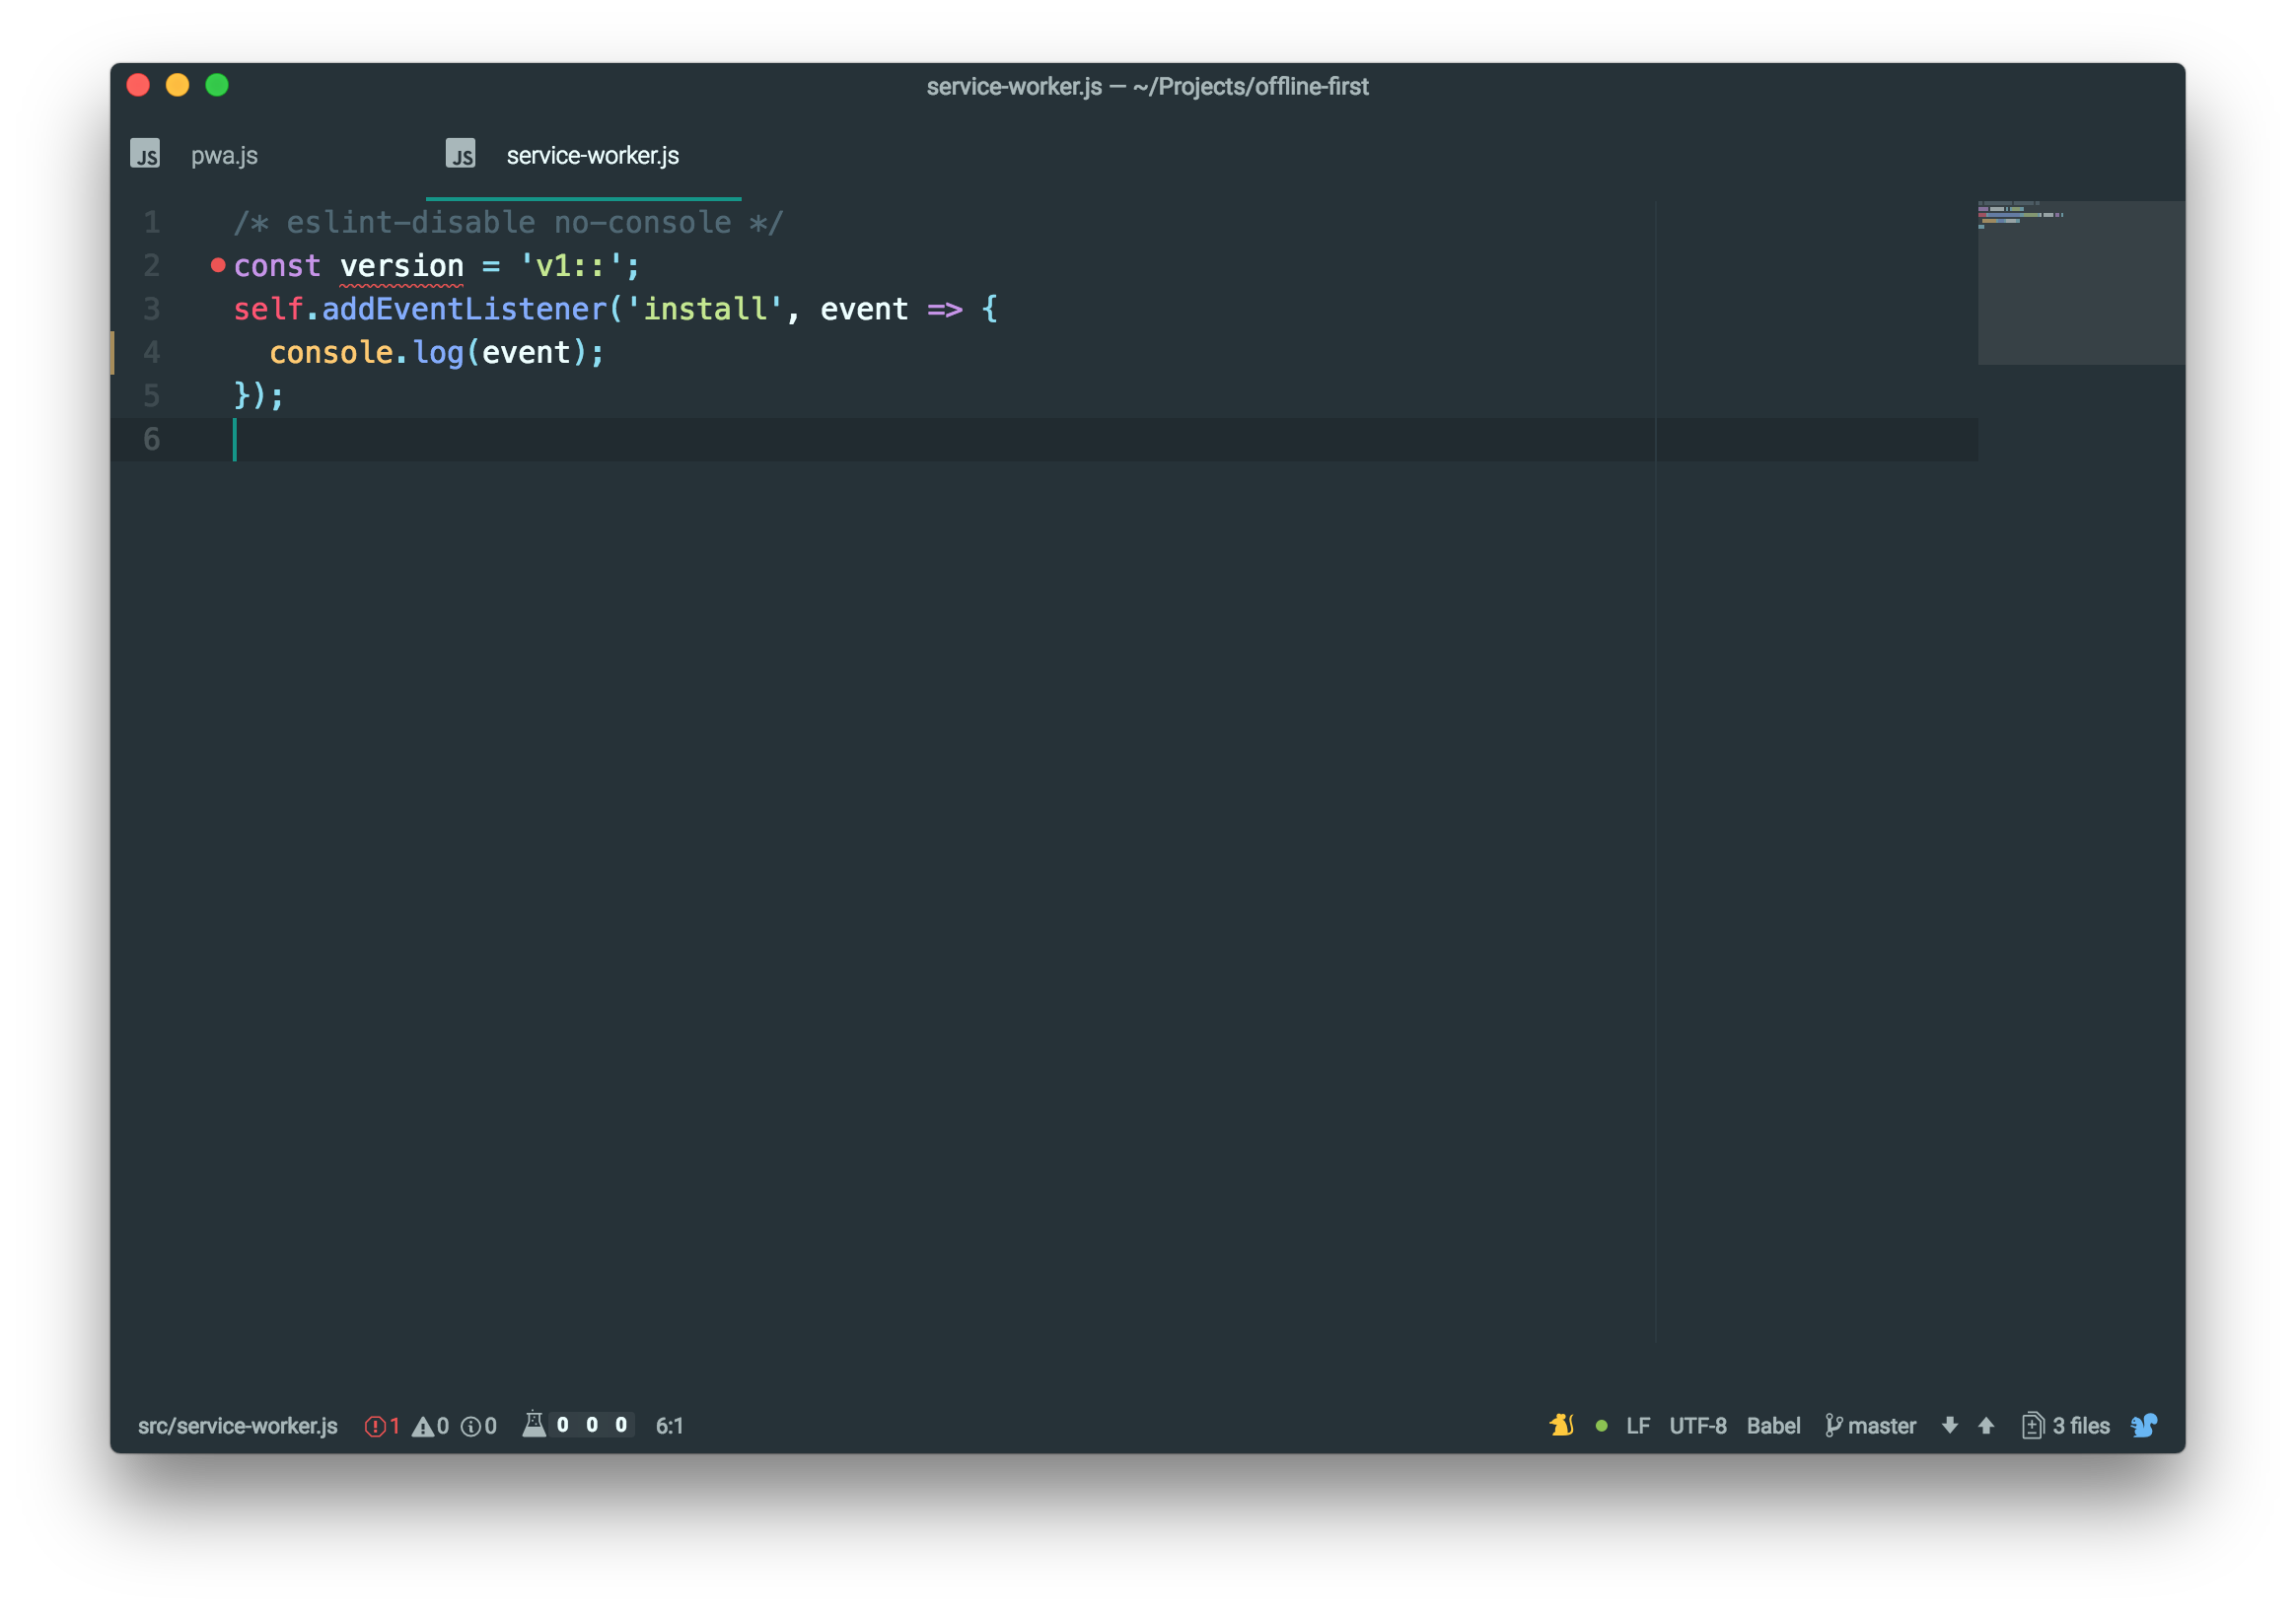

Slide 13


Slide 14
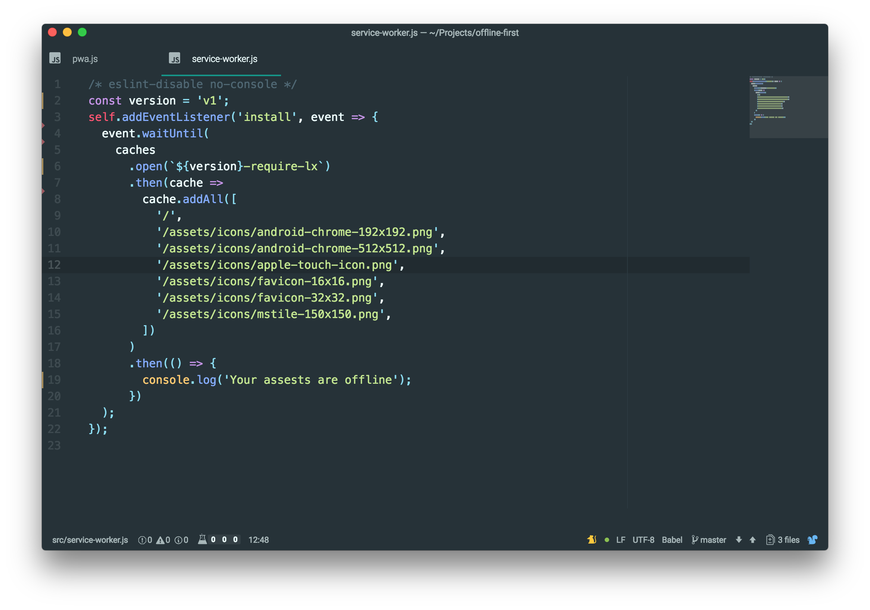

Slide 15


Slide 16
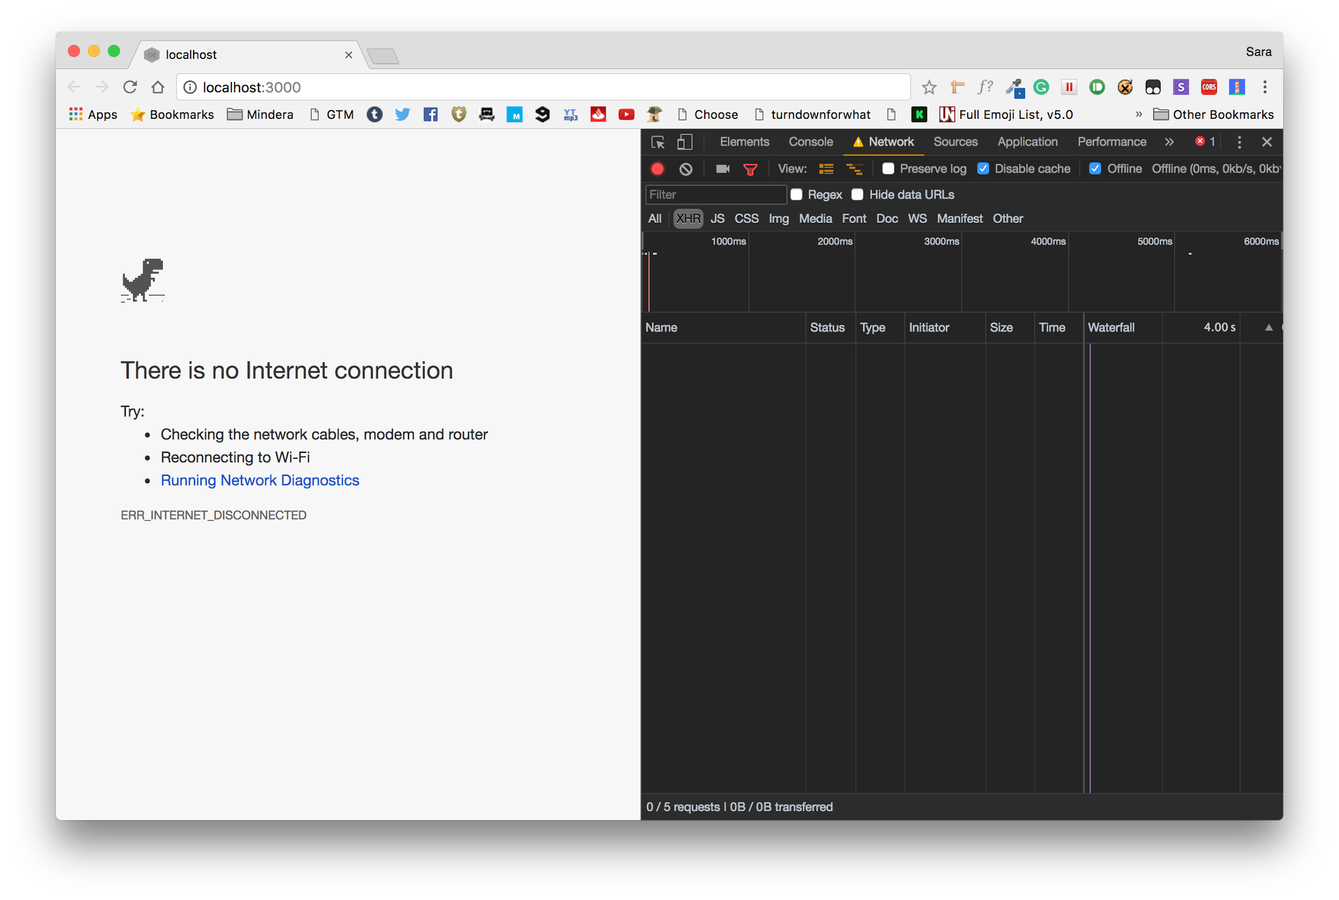

Slide 17
Activating a service worker

Slide 18
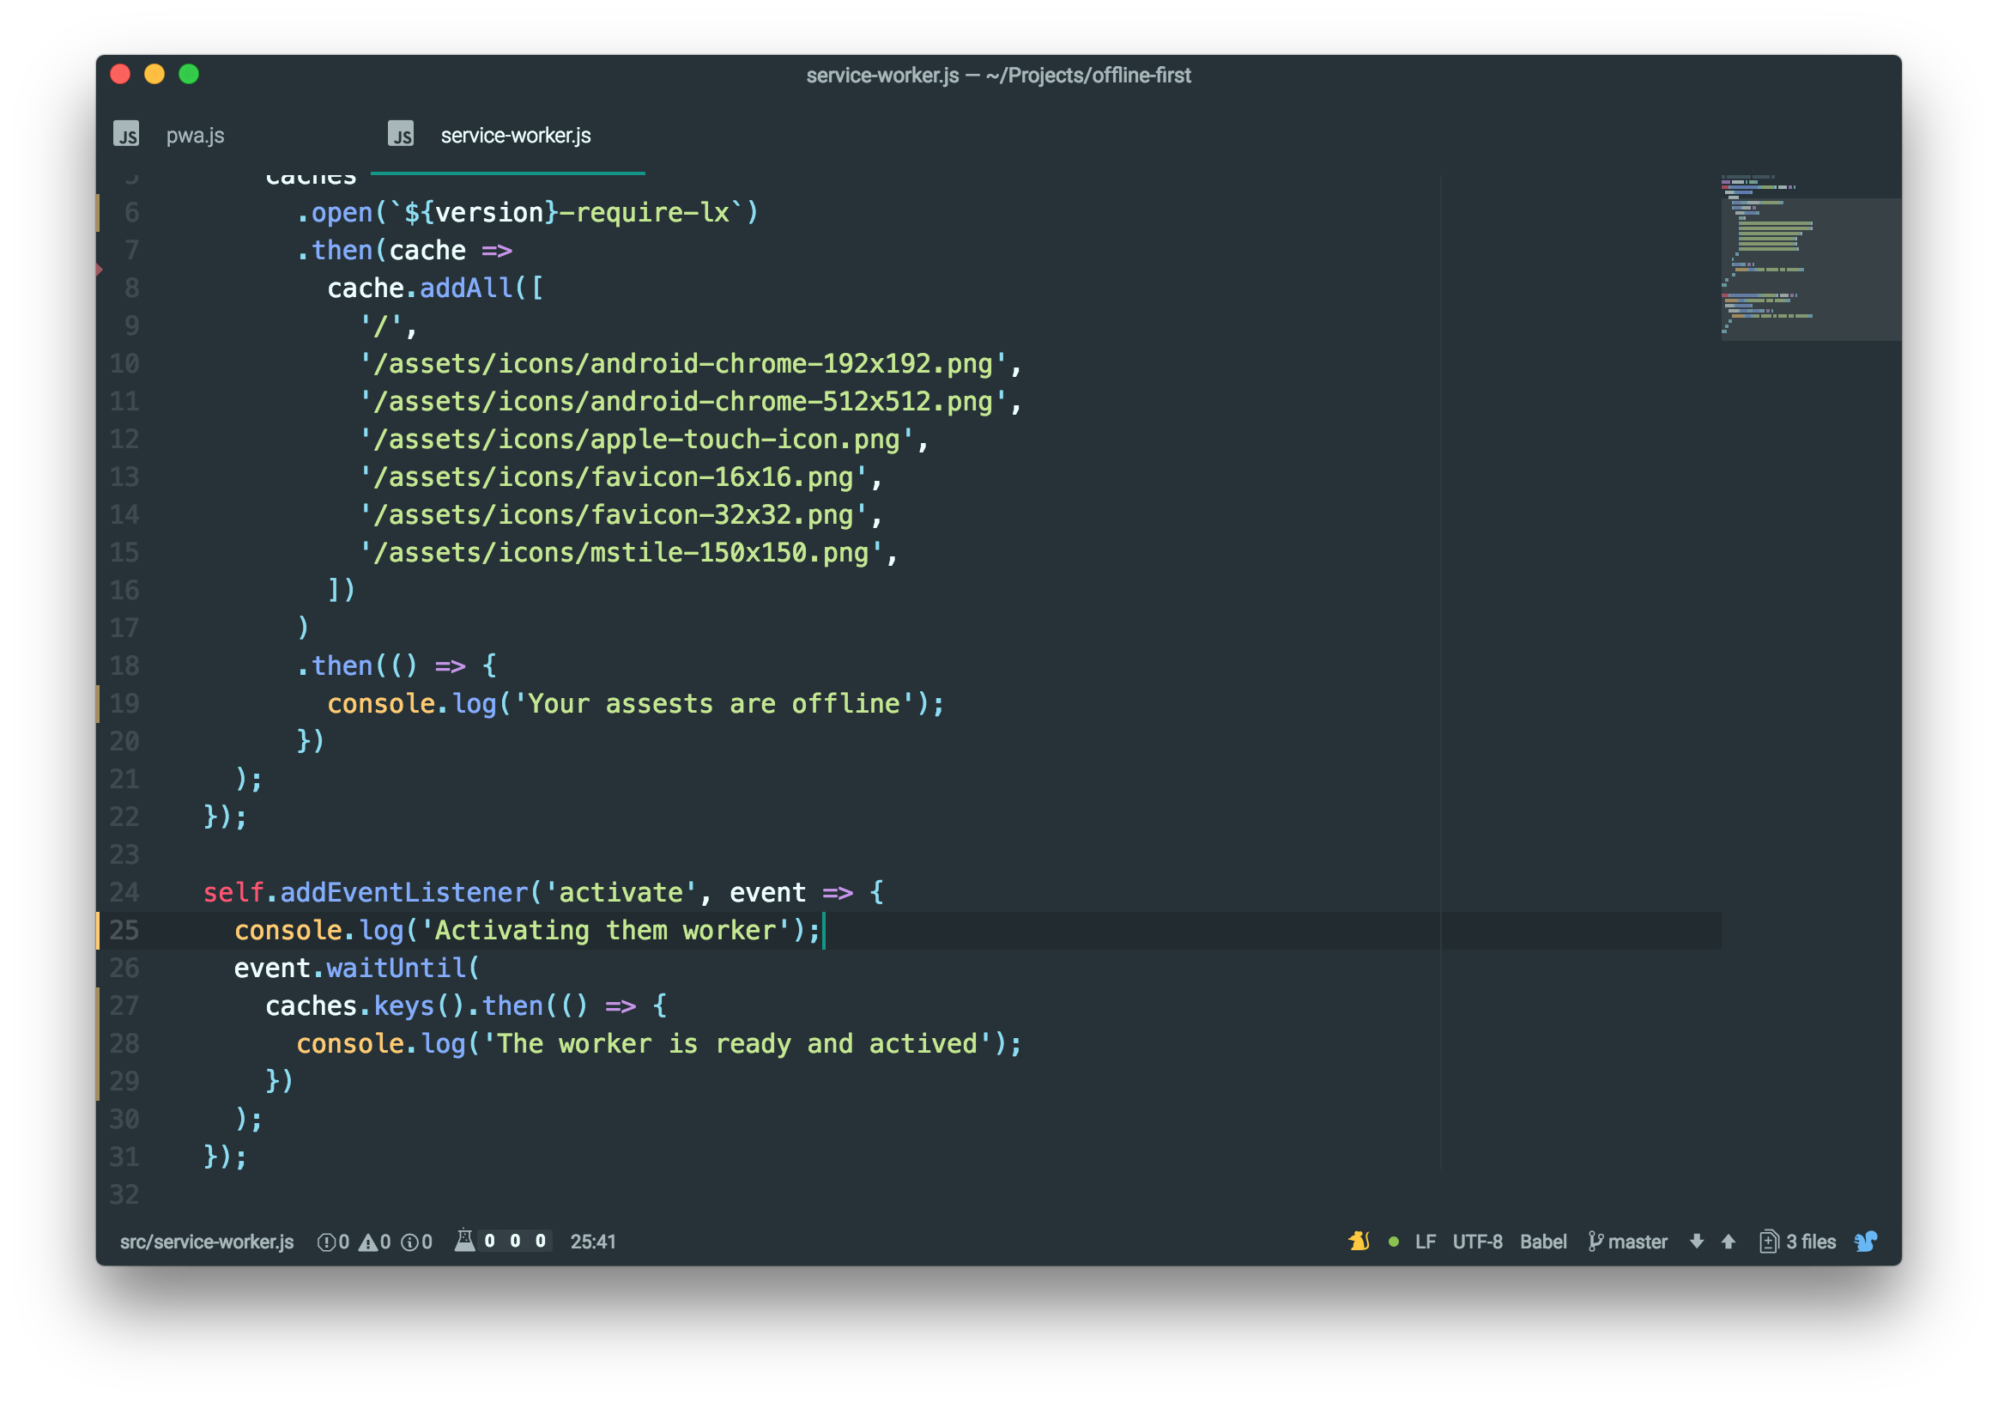

Slide 19


Slide 20
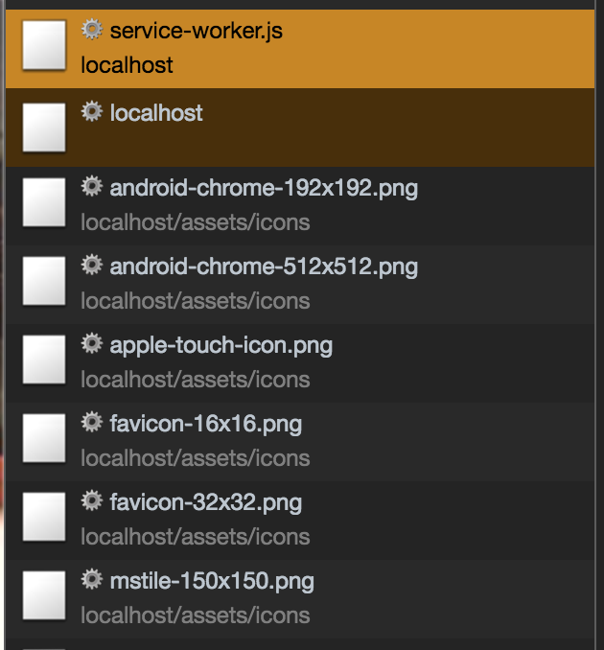

Slide 21
Fetching with a service worker

Slide 22
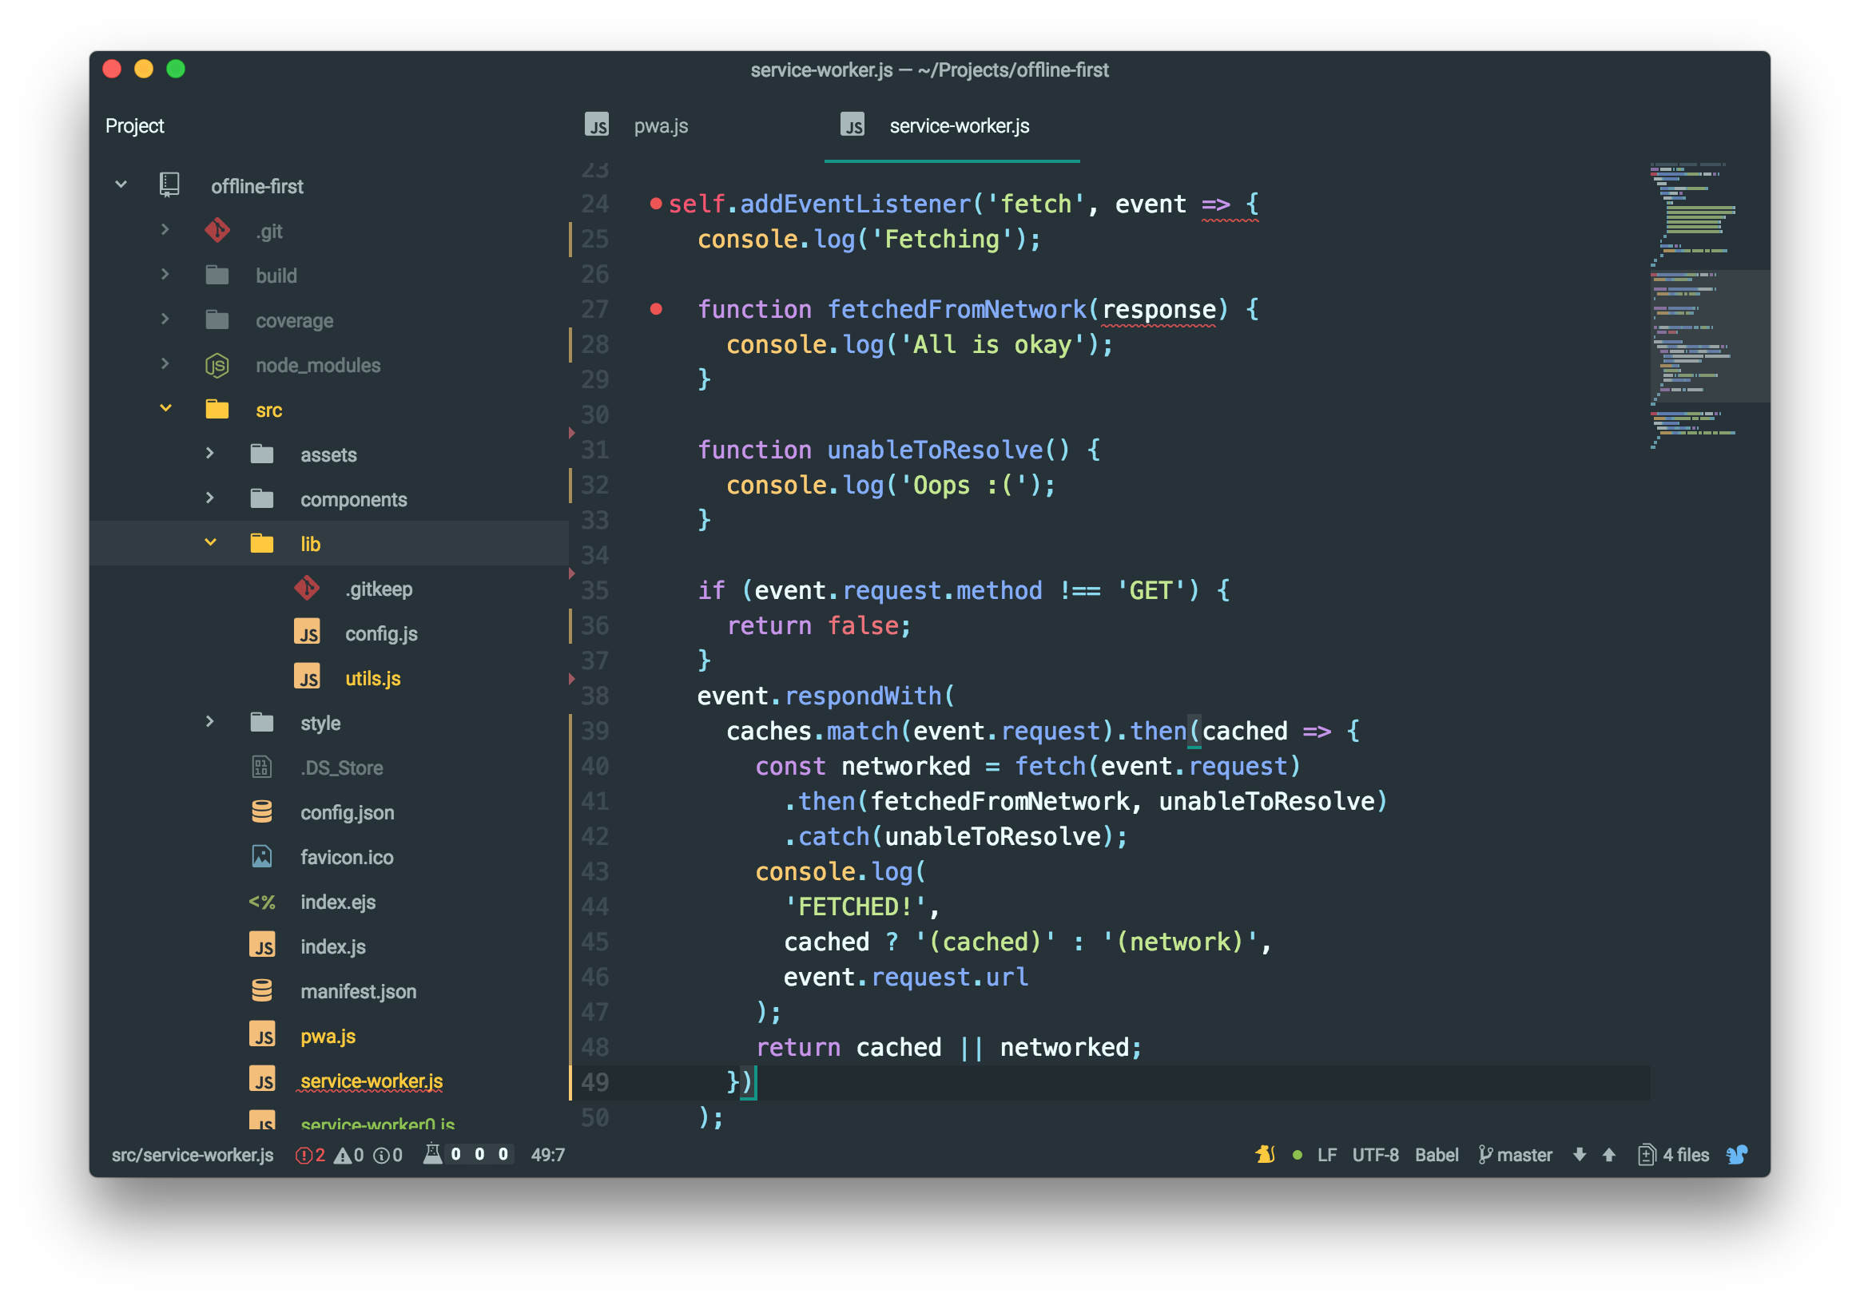

Slide 23
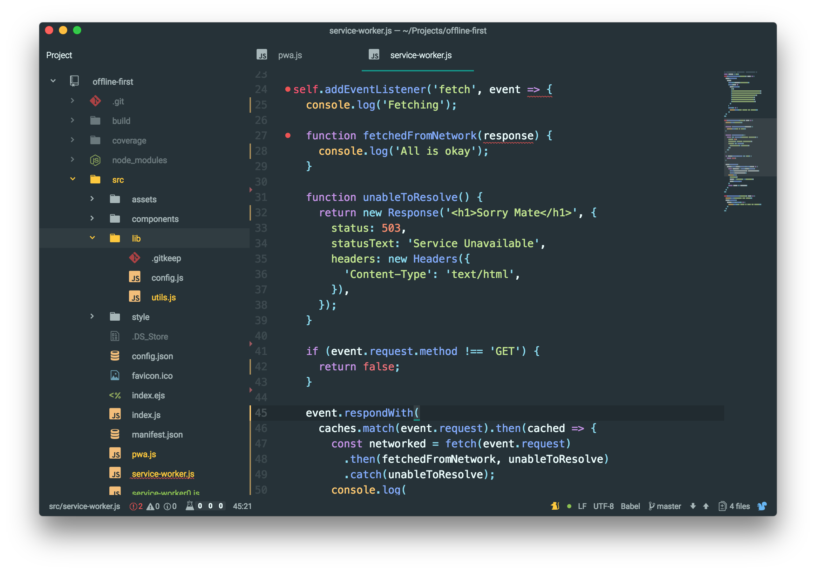

Slide 24
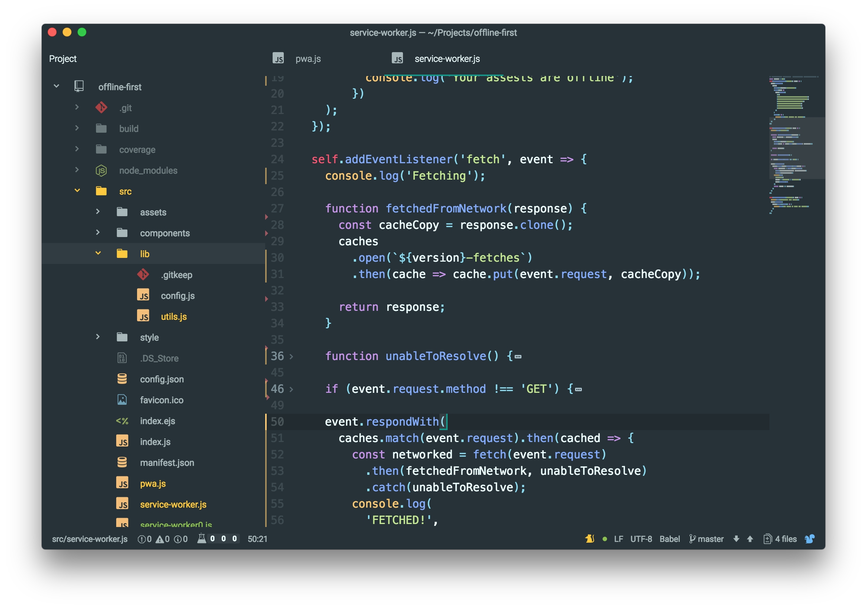

Slide 25
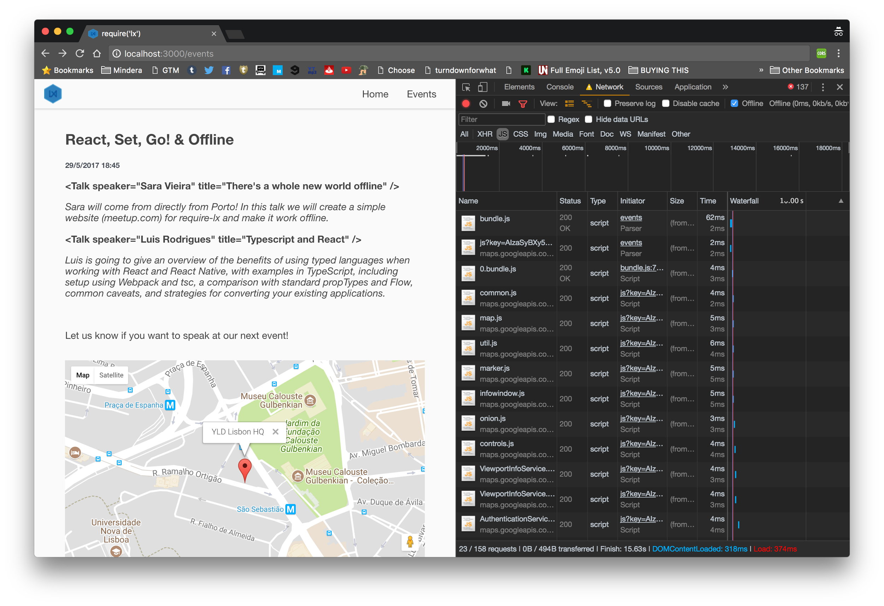

Slide 26
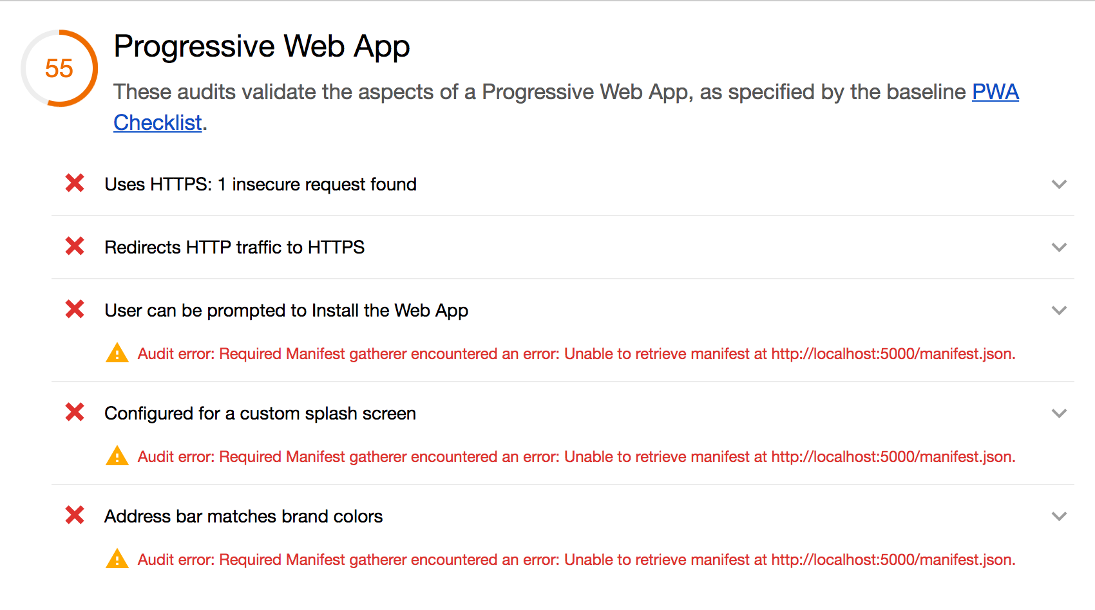

Slide 27
Let’s Create a Manifest

Slide 28
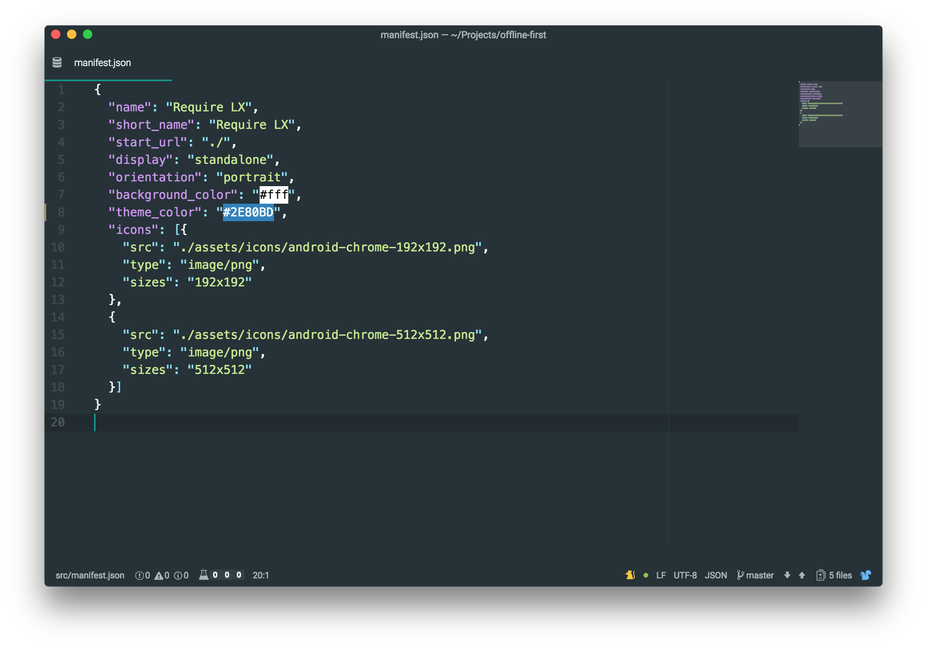

Slide 29
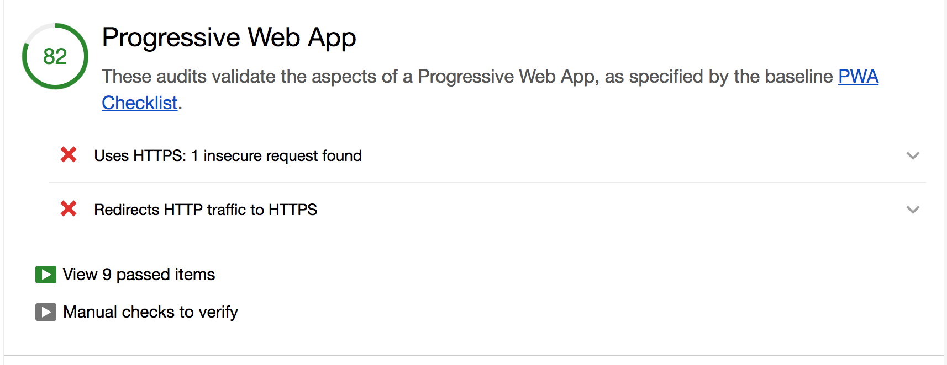

Slide 30
What if we deployed it?

Slide 31
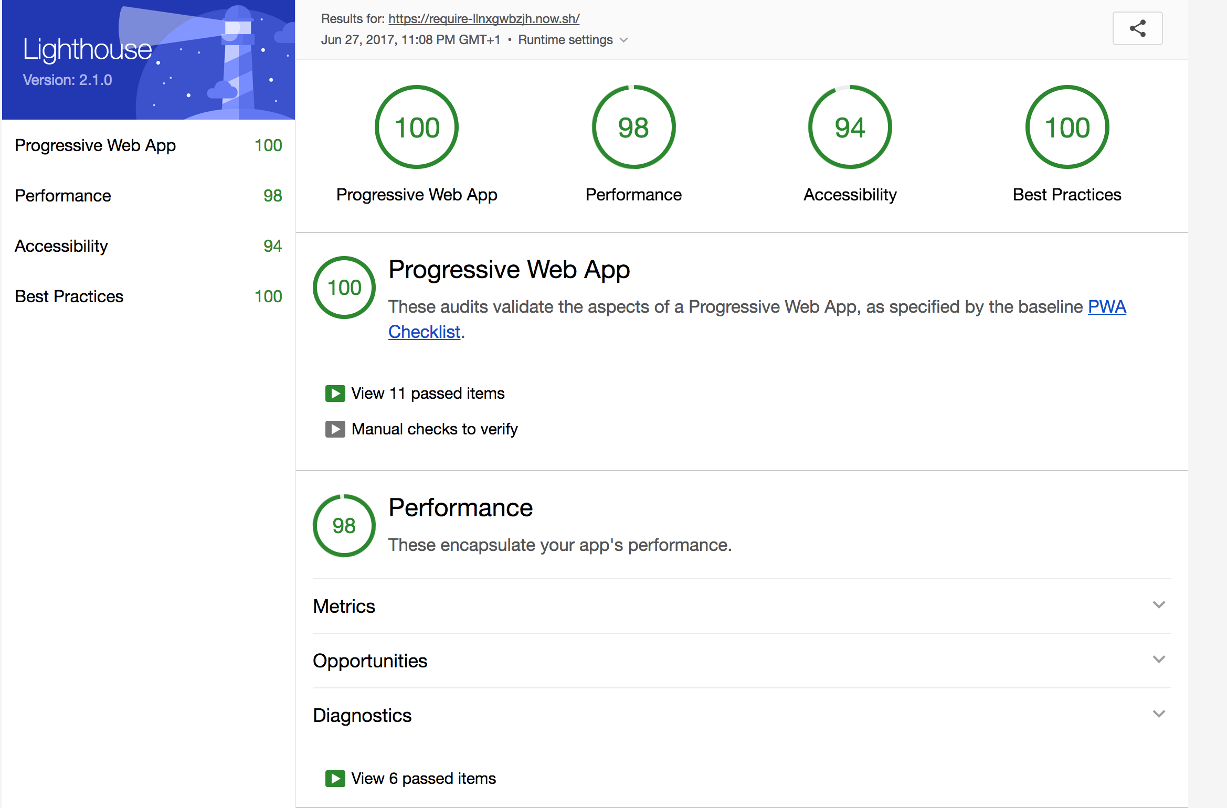

Slide 32
Thank You
github.com/SaraVieira/offline-first-require-lx

